Slide 1
Project Title
Fatima Ali Tirmizi, Fizza Adeel,
Irtaza Ahmed Khan, and Malaika Sultan

Slide 2
Problem Statement
Traditional Manual Processes
Inefficiencies
Wastage
Inadequate Demand Forecasting
Outdated Supply Chain Mechanisms
Communication Issues
Mobiler
Labour Intensive Processes

Slide 3
Existing System
Stock Outs
Arrival of Supplies
Slow Replenishment
Conventional Procurement Structure
Significant Time Investment
Challenges Faced by Wholesalers and Distributors
Small Customer Base
Limited Reach
Information Gaps

Slide 4
Additional Research
Conducting interviews with different grocery store owners
Communication issues with vendors
Authentic or a ‘Mobiler’
Manually check how much of the items are left
Only source to new products is through vendors
Related Systems
Shelf Engine
Guac
Tajir

Slide 5
Proposed Solution
Automating the Grocery Industry
Reducing Food Waste Using Demand Forecasting System (ML)
Advanced Data Analytics and Machine Learning Leveraging System
Overstocking or Understocking Risk Mitigation
Optimise Grocery Sales with Demand Trends and Factors i.e. Weather, Traffic, and Housing Prices.

Slide 6
Proposed Solution
Vendor-Grocery Stores Collaborative Platform
Registration
Authentication of Users
Develop Connections
Order Tracking
Intuitive Navigation for Sales and Purchases
Assisted Vendor Search for Specific Products

Slide 7
Deliverables
App - Grocery Stores / Vendors
Website - Admin Portal
ML Model - Demand Forecasting
REST API - Frontend & Backend Communication
Database - Data Storage

Slide 8
Technologies
Programming Languages:
Python
Java
JavaScript
Dart
Data Storage:
MySQL
Cloud Services:
Amazon Web Services

Slide 9
Technologies
Web Development:
Front-End
React
Back-End
Spring Boot
Mobile Development:
Flutter

Slide 10
Technologies
REST API:
Spring Boot
Version Control:
GitHub
Project Management:
Jira
Collaboration:
Slack

Slide 11
Business Model
Advertising and Promotion Revenue Stream
Product Promotion:
Showcase Products Prominently (Vendors)
Feature in Dedicated Sections, Banners, or Listings
Sponsored Product Listings
Monetization:
Charge for Premium Product Placements
Implement Pay Per Click (PPC) or Pay-Per-Impression (PPI) Model
Revenue from Sponsored Listings and Banners

Slide 12
Project Methodology
Project Initiation (Week 1-3)
Requirement Gathering (Week 4-6)
System Design (Week 7-9)
Development (Week 10-33)
Testing and Quality Assurance (Week 13-33)
Deployment (Week 34-36)
Maintenance (Ongoing)

Slide 13
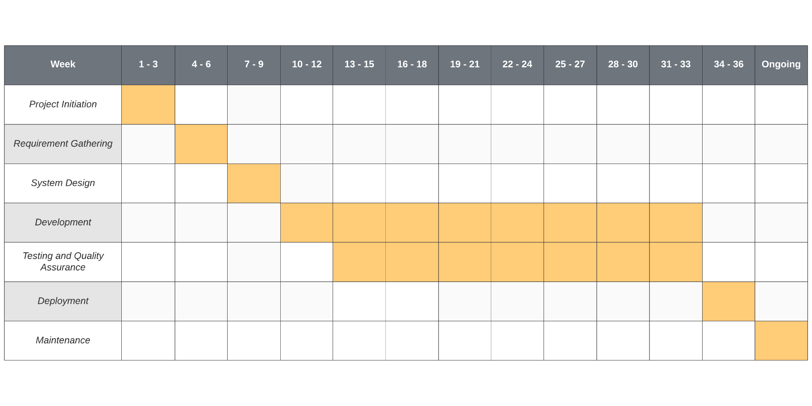
Timeline

